Slide 1


SMART ENERGY SAVING SYSTEM USING COMPUTER VISION & IOT
Team Members :-Piyush Kumar
Piyush Chaudhary

Slide 2


PROBLEM STATEMENT
  Lights and Fans remain ON in empty classrooms.
  Electricity is wasted.
  Manual switching is often forgotten.

Slide 3
EQUIPMENTS USED
•ESP32
•OLED(Organic Light Emitting Diode)
•Relay Module
•Bulb
•YOLOv8 (Software)

Slide 4
SOLUTION
  Camera detects classroom occupancy.
  YOLO processes the video to identify people.
  ESP32 receives the occupancy status.
  ESP32 controls the relay.
  Relay switches OFF lights/fans after the room remains empty for a preset time.

Slide 5
WORKING
Camera
↓
YOLO
↓
Count People
↓
(Occupancy Decision)
If People > 0 → OFF
If People = 0 for X Minutes → ON
↓
ESP32
↓
Relay Module
↓
Light/Fan

Slide 6
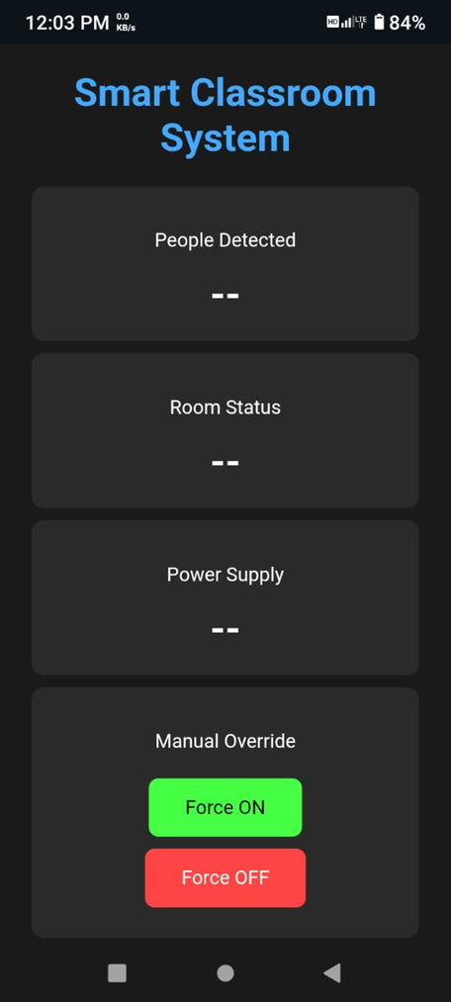
MANUAL OVERRIDE WEBPAGE

Slide 7
PROJECT DEMO

